Slide 1


Sponsored Programs Administration Resource & Knowledge Series
AWARD MANAGEMENT
PART I
Presented by:
Terri Vallery & Kristin Wetherbee

Slide 2
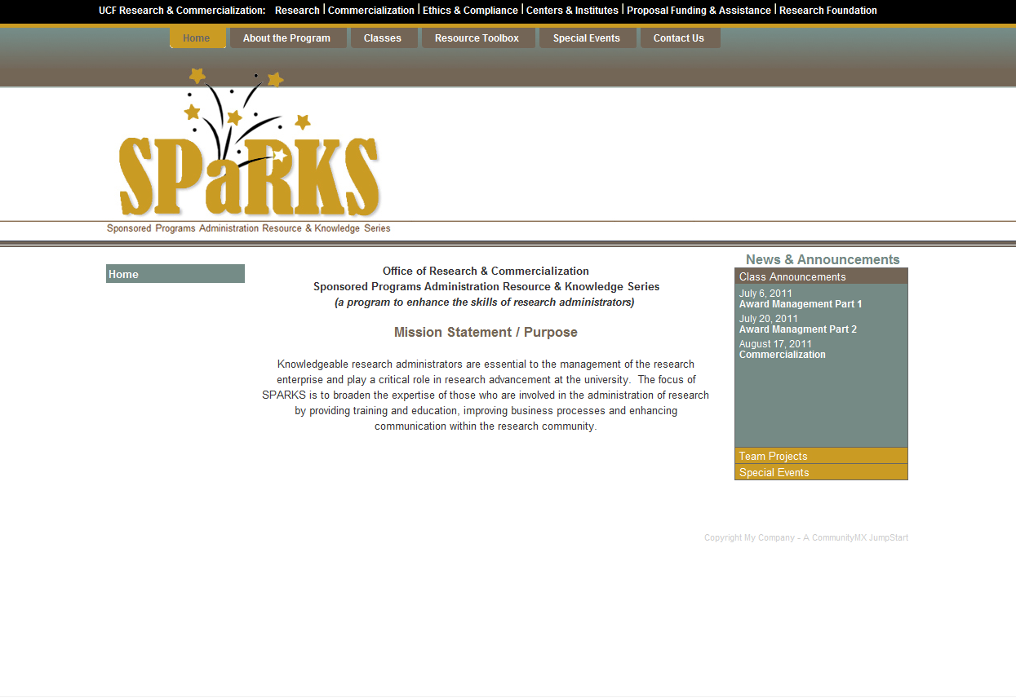
General Business
Please visit SPaRKS website for current course materials!
www.sparks.research.ucf.edu
AWARD MANAGEMENT – PART I

Slide 3
General Business
Interested in Certification?
Want to Be a Certified Research Administrator?
http://www.cra-cert.org/
Email Doshie Walker to let her know that you are interested in attending the CRA study group!
AWARD MANAGEMENT – PART I

Slide 4
General Business
CERTIFICATE CEREMONY
August 29th
COMMERCIALIZATION

Slide 5

Exploring Research Administration from Concept to Commercialization

Slide 6
Exploring Research Administration from Concept to Commercialization
AWARD ACCEPTANCE
What is considered acceptance?
Terri Vallery & Kristin Wetherbee

Slide 7
AWARD ACCEPTANCE
What does “acceptance” mean?
  Depending on award type, acceptance means:
    Fully-executed two-party agreement
    Unilateral award from sponsor
    Commencing work or acknowledging receipt of T&Cs
  Requires certain documents on file (at a minimum):
    SOW
    Budget
    PTF (prior to account establishment)
AWARD MANAGEMENT – PART I

Slide 8
Exploring Research Administration from Concept to Commercialization
AWARD ESTABLISHMENT
Award Types
Pre-Award Costs & Advance Set-up
Award Actions
Account Types
Setting up Budget
Notifying the PI
Other Considerations
Terri Vallery & Kristin Wetherbee

Slide 9

THINK ABOUT IT…
Which of the following describes a fixed-price agreement?
  a. Prevents cost overruns.
  b. Is usually riskier than a cost-reimbursable agreement.
  c. Requires financial reporting to the sponsor.
  d. Has a longer project period than a cost-reimbursable agreement.
AWARD NOTIFICATION & NEGOTIATION

Slide 10
AWARD ESTABLISHMENT
Award Types
Fixed
Cost Reimbursable
Time & Materials
AWARD MANAGEMENT – PART I

Slide 11
AWARD ESTABLISHMENT
Pre-Award Costs / Advance Set-up
  Typically no more than 90 days prior to start date
  At the risk of the recipient
  Does not obligate sponsor to fund more than award amount
AWARD MANAGEMENT – PART I

Slide 12
THINK ABOUT IT…
True or False?
With incremental funding,
spending limits can NEVER be exceeded.
AWARD NOTIFICATION & NEGOTIATION

Slide 13
AWARD ESTABLISHMENT
Award Actions
New Award/Competing Award | New research project funded competitively for the first time
Continuation/Non-competing Award | Incremental funding of a previously approved project
Renewal/Competing Continuation | Continuing project funded competitively for a new project period
Supplemental Award | Additional funding provided during a previously-approved budget period (ex. REU supplement to a NSF award)
Modification/Amendment | Budget modification, change in SOW or research plan, change of project personnel or level of effort, administrative changes, termination
AWARD MANAGEMENT – PART I

Slide 14
AWARD ESTABLISHMENT
Education & General (E&G)
Contracts & Grants (C&G)
UCF or RF
Auxiliary
Research Foundation
Account Types
AWARD MANAGEMENT – PART I

Slide 15
AWARD ESTABLISHMENT
Setting up the Budget
PI Spending Authority
University Recovery
Direct Costs
Cost Share
    F&A Costs
AWARD MANAGEMENT – PART I

Slide 16
AWARD ESTABLISHMENT
Budget Levels
Level 1 (least restrictive) | All direct costs rolled up into Salary F&A
Level 2 | Salary (with OPS rolled up) Equipment Remaining Direct F&A
Level 3 | Salary Other Personnel Services (OPS) Expenses Equipment F&A
Level 4 (most restrictive) | All direct costs broken out by category F&A
AWARD MANAGEMENT – PART I

Slide 17
AWARD ESTABLISHMENT
Notifying the PI
  Spending Authority
    Direct Costs
    Cost Share
  Terms & Conditions related to the technical effort
  Reporting Requirements
AWARD MANAGEMENT – PART I

Slide 18
AWARD ESTABLISHMENT
When there are Other Considerations
  PTF outlines other issues that may need to be addressed:
    Conflict of Interest
    Research Misconduct
    Human Subjects Protection
    Animal Subjects Protection
    Hazardous Materials
    Responsible Conduct in Research
    Export Control
AWARD MANAGEMENT – PART I

Slide 19
Exploring Research Administration from Concept to Commercialization
AWARD MANAGEMENT
Pre-Expenditure Review
Project Deliverables/Reporting
Subrecipients & Subrecipient Monitoring
Budget Transfers
Cost Transfers
No Cost Extensions
Termination
FDP & Expanded Authority
PI Relocation
Terri Vallery & Kristin Wetherbee

Slide 20
AWARD MANAGEMENT
Pre-Expenditure Review
  Certain research expenditures require ORC review/approval:
    Equipment
    Travel
      All foreign travel
      All domestic travel >$2,000
    Services > $1,000
AWARD MANAGEMENT – PART I

Slide 21
AWARD MANAGEMENT
Project Reporting / Deliverables
  Failure to deliver may lead to non-payment and project termination, leading to revenue deficits and other losses.
Technical
Administrative
Financial
AWARD MANAGEMENT – PART I

Slide 22
AWARD MANAGEMENT
Subrecipients & Subrecipient Monitoring
  Prime is responsible for conduct and completion of project
  Progress reports & invoices should be reviewed and approved by PI
  Issue award funding in increments (e.g., yearly basis) to provide a check/balance opportunity to review progress/performance, discuss issues, review expenditures
  F&A is charged on first $25K only (for awards calculated using MTDC); monitor to ensure this is charged correctly
AWARD MANAGEMENT – PART I

Slide 23
AWARD MANAGEMENT
Subrecipients & Subrecipient Monitoring
  Some things to consider:
  Consider ending subawards early in the final year to assure sub has ample time for their close-out, and UCF also has at least 90 days to close-out
  Consider modifying flowed-down award terms and reducing sub close-out period to 45 or 60 days, rather than the standard 90 days
AWARD MANAGEMENT – PART I

Slide 24
THINK ABOUT IT…
An investigator on an NSF grant has permission to rebudget $150,000 in renovation budget into equipment. If the institution’s F&A rate is 54%, how much money will be available for the equipment?
  a. $69,000
  b. $81,000
  c. $97,403
  d. $150,000
AWARD NOTIFICATION & NEGOTIATION

Slide 25
AWARD MANAGEMENT
Budget Transfers
  Moving available budget from one line item to another within one project account.
AWARD MANAGEMENT – PART I

Slide 26
AWARD MANAGEMENT
Budget Transfers
  Adequate budget must be available in the affected categories.
  Request must come from PI/other authorized individual on DAL.
  Consider any sponsor restrictions
    Ex. % of total that may be transferred without sponsor approval
AWARD MANAGEMENT – PART I

Slide 27
AWARD MANAGEMENT
Budget Transfers
Examples of Inappropriate Requests
  To reflect spending pattern
  To clear a deficit or use remaining funds
  For expenditures otherwise unallowable
AWARD MANAGEMENT – PART I

Slide 28
AWARD MANAGEMENT
Budget Transfers
Examples of Appropriate Requests
  To adjust for minor changes related to labor costs
    Ex. Budget in Salary moved to OPS for additional grad students
  To purchase previously unbudgeted piece of equipment (with sponsor approval)
  To accommodate approved changes in SOW
AWARD MANAGEMENT – PART I

Slide 29
AWARD MANAGEMENT
Budget Transfers
Typically Budget Transfers:
  Will not change the scope of the work
  May be the answer to correct an error
  Are meant to meet the aims of the grant
AWARD MANAGEMENT – PART I

Slide 30
AWARD MANAGEMENT
Cost Transfers
  Moving expenditures off of one project onto another.
Project A
Project B
AWARD MANAGEMENT – PART I

Slide 31
AWARD MANAGEMENT
Cost Transfers
Questions to Consider:
  Did the expense benefit the award?
  Was the expense incurred during the project or budget period of the award?
  Should the expense be allocated between sources?
  Is the expense allowable according to sponsor guidelines?
  Is there an inordinate amount of cost transfers being placed on or removed from the project?
  Are we at the end of the project period?
AWARD MANAGEMENT – PART I

Slide 32
AWARD MANAGEMENT
Cost Transfers
What are auditors looking for?
  Length of time between original expense posting and transfer
  Processing cost transfer after grant has ended
  Transferring from an over spent project to another
  Transfers of partial amount
  Burden of proof, in case of audit, is on UCF not auditor
AWARD MANAGEMENT – PART I

Slide 33
AWARD MANAGEMENT
Cost Transfers
Examples of Inappropriate Cost Transfer requests:
  To clear a deficit
  Error made; no other information
  To utilize available funding
  For convenience
AWARD MANAGEMENT – PART I

Slide 34
AWARD MANAGEMENT
Cost Transfers
Examples of Appropriate Cost Transfer requests:
  Error correction
  Continuation costs
  Cost transfers between tasks of the same sponsored project
  Costs benefitting more than one project
  Costs transferred in anticipation of a cost overrun
  Disallowed costs
  Reallocation of salary to reflect actual effort
AWARD MANAGEMENT – PART I

Slide 35
THINK ABOUT IT…
A No Cost Extension may be requested for the following reasons:
  a. To allow for additional time to complete technical or programmatic work.
  b. To allow for additional time to complete the close-out process.
  c. To allow for the expenditure of remaining balances.
  d. All of the above.
AWARD NOTIFICATION & NEGOTIATION

Slide 36
AWARD MANAGEMENT
No Cost Extensions
  Additional time (not funds) for completion of approved SOW
  No Cost Extensions may not:
    Be requested for the purpose of using unobligated funds
    Propose any new activities
AWARD MANAGEMENT – PART I

Slide 37
AWARD MANAGEMENT
Termination
Mutual vs. Unilateral
Cause vs. Convenience
All work must cease.
Obligations that can be canceled, must be canceled.
Those that can’t, should be honored and reimbursed.
A stop work order (not termination) on a fixed price agreement typically changes the payment methodology to cost-reimbursable.
AWARD MANAGEMENT – PART I

Slide 38
AWARD MANAGEMENT
PI Relocation
Award staying with UCF?
  Seek agency approval for change of PI.
  Will we subcontract the former PI at their new institution?
Award transferring to PI’s new institution?
  Will equipment remain at UCF or transfer as well?
  Will UCF be subcontracted?
  Has UCF posted, invoiced, and been paid for all final costs?
  What amount are we relinquishing?
AWARD MANAGEMENT – PART I

Slide 39
AWARD MANAGEMENT
Federal Demonstration Partnership & Expanded Authority
What is the Federal Demonstration Partnership (FDP)?
  A cooperative initiative among 10 Federal agencies and 120 institutional recipients of federal funds working together to streamline research administration processes
4 types of membership:
  Research Institution
  Emerging Research Institution
  Federal Agencies
  Affiliate Organization
AWARD MANAGEMENT – PART I

Slide 40
AWARD MANAGEMENT
Federal Demonstration Partnership & Expanded Authority
Work in phases every 4 years (currently in Phase V) working off of a 4-year strategic plan.
Current initiative based mostly on the Faculty Administrative Burden Survey.
Created a standard FDP Subaward for ease in subcontracting among FDP organizations.
AWARD MANAGEMENT – PART I

Slide 41
AWARD MANAGEMENT
Federal Demonstration Partnership & Expanded Authority
Most notable accomplishment = Expanded Authority
Participating Federal agencies have a matrix list of expanded authority permissions
  ex. 90-day pre-award, one-year NCEs
AWARD MANAGEMENT – PART I

Slide 42

QUESTIONS or COMMENTS?

Slide 43
THANKS FOR JOINING US!
Please come to the next session:
AWARD MANAGEMENT (PART II)
August 8th, 2012
10:00 am to 12:00 pm
Sponsored Programs Administration Resource & Knowledge Series

